Slide 1
Navigating Automata
David Gee
@_ipengineer
dave.dev / ipengineer.net
me@dave.dev
Without a map

Slide 2
What starts as frustration, will either kill you or turn into something
Networking – is a graph
Everything in networking is a graph
Graphs are everywhere in networking.
Everywhere, there are graphs in networking…I’ll stop now…
Automation is ultimately a labelled transition system (graph) that allows us to model things like finite state machines. We call these things stateful workflows :s

Slide 3
What starts as frustration, will either kill you or turn into something (right?)
Workflows: Directed Acyclic Graphs (sorry)
Workflows are your map to your intended moment in time desired state.
- End-state is never a thing; networks are without an ‘end-state’
Workflows mechanized, come in two distinct flavours:
Productized automation like ACI and Contrail (do graph things)
Generic workflow engine (graph engine)
The frustration: Workflow (graphs) that react to external impulses (graph) to mutate network (graph) state (graph)…can you guess what they need?

Slide 4
Where are we as an industry?
Automate the keyboard
First generate config
Throw it at box
Hope for the best
Then came unit tests
But what if we test first for pre-state and potential collisions…like a human does?
Then what if we check for post state to make sure the management plane is in the state we want?
Separation of host variables from input, then render via actuation…
Keyword tests for cfg & ops (if you’re skilled enough to use Robot)

Slide 5
Where are we as an industry?
ASN: 65500
Templates
Tool
inet.1/30
Host
eBGP Session
Etc…
Host Vars
inet.2/30
Directives
ASN: 65501
Pre
Task1
Task2

Slide 6
Where are we as an industry?
Explosion of automation
Ansible, RunDeck, Salt, Puppet, Chef, StackStorm, StableNet, Apstra, Tungsten Fabric – all human based ☹
If we use these for networking, do you KNOW WHAT’S MISSING?
You guessed it…a b***dy graph

Slide 7
Where are we as an industry?
Producitzed Automata
?
Workflow Engine based or Scripts
?
DEV
OPS
Every tool is “heroic”, in its own special snowflake way
The industry is still trying to make DevOps fit bottom-up (blast radius 1)

Slide 8
Where are we as an industry?
The Panacea
DEV
OPS
%#*(**(#%*Q*&*#&*&*(#@&$
Union of Experience
Every tool is “heroic”, in its own special snowflake way
The industry is still trying to make DevOps fit bottom-up (blast radius 1)
There is a blackhole in the middle of every automation system sucking the life out of possibility (and my soul)

Slide 9
Where are we as an industry?
We shall use a tool.
The kingdom shall rejoice and pay many taxes.
Network Control >>>
We don’t design, nor model and rarely verify
We don’t have a formal language (even structured programming ~70yrs old now)
Python/Ansible blinding the industry
Automata is more complex than if-else statements

Slide 10
Where could we be?
Eventual Consistency
ASN: 65500
Host
API
Graph Directives
inet.1/30
API
eBGP Session
Etc…
inet.2/30
Graph Cfg
Graph Ops
ASN: 65501
Declarative
Ordered
Atomic
Physical / Cabling / Logical
Constant Discovery
Absolute Knowledge
Handles Dynamism
DNA System
Pre
Graph Deploy

Slide 11
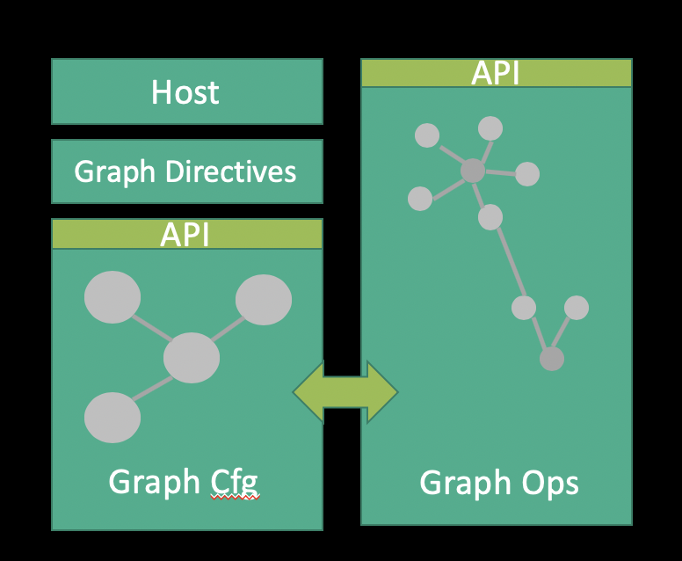
What I’m trying to do about it at Juniper
Release Terraform Providers for Junos that are generated from YANG (graph) models
Terraform has a graph engine for configuration changes, that deals with CRUD (properly)
Build or open source a graph ops engine

Slide 12
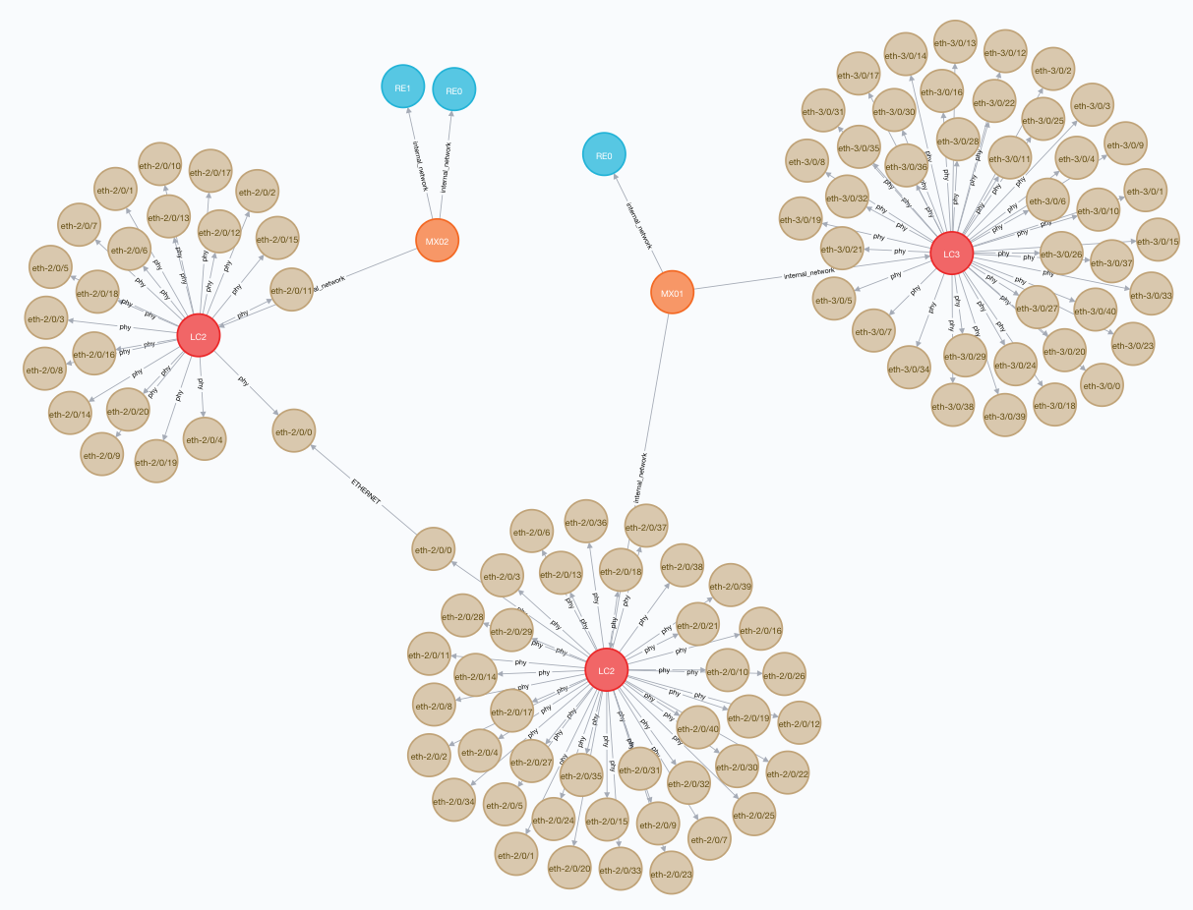
Super early experimental work, but showing promise.
Build on Neo4j, with Go, GPB and NATS to glue things together.
Will hopefully come back in the future with more info and a demo!

Slide 13
Thank you!
(Hopefully not too ranty)

